Slide 1

C.K. PITHAWALLA COLLEGE OF COMMERCE MANAGEMENT AND COMPUTER APPLICATION DUMAS SURAT
REPORT ON
Food Delivery Website
Submitted By: Guided By:
Vishwakarma Abhishek Ramvriksh (7281) Mrs. Hetal Mehta
Dubey Vishal Jaykumar (7185)
Singh Abhishek Jitendra (7262)
Chaudhary Ajit Ashokkumar (7177)

Slide 2
Contents
Introduction
Project Profile
Project Introduction
Environmental Description
Hardware & Software Requirements
Tools & Technology
Existing System
Manual ordering via calls or visits with no digital tracking or automation.
Proposed System
Aim & Objectives
Scope
Expected Advantages
UML Diagrams
Use Case Diagrams
System Diagrams
Table Structure
Screen Layout

Slide 3
INTRODUCTION
Project Profile
Project Introduction

Slide 4
Project Profile
Project Title : NomNomGo.
Project Type : Food Delivery Website
Project Objective : To provide platform for purchasing food & Delivery
Project Guide : Prof. Hetal Mehta
Team Member : 4
Front-End : HTML, CSS, JavaScript, React.js
Back-End : Node.js, Express.js
Authentication : JWT-based secure login system
Payment Gateway : Stripe
Submitted By : Vishwakarma Abhishek Ramvriksh (7281)
Dubey Vishal Jaykumar (7185)
Singh Abhishek Jitendra (7262)
Chaudhary Ajit Ashokkumar (7177)

Slide 5
Project Introduction
“NomNomGo.” is online food delivery website which connects the customers & restaurants for selling the food items.
Customers can able to purchase food items
Customer give feedback on purchased product.
Our website offers a range of food items such as salads, rolls, deserts, sandwiches & among other food categories.
Our website delivers good quality & healthy hygiene food to the customer’s door step. By delivery partner.
Customer can easily filter food items according to there choice.
Easy payment method safe and secure.

Slide 6
Project Introduction
Hardware & Software Requirements
Tools and Technology

Slide 7
Tools
Documentation Tools
Development Tools
MS Word
Draw.io
MS Power Point
Vs Code

Slide 8
Technology
Core Technology
Extra Technology
MongoDB
Express.js
React.js
Node.js
Mongoose
JWT
Bcrypt.js
Axios
React Queary

Slide 9
Existing System
Customers place orders by phone or in person.
No online menus or browsing options.
Payments are made in cash or offline methods.
Delivery coordination is done manually.
No real-time tracking or order management system.

Slide 10
Proposed System
Aim
To develop a digital food delivery platform that streamlines ordering, payment, and delivery processes for customers, restaurants, and delivery agents.
Objective
Enable online food ordering from multiple restaurants via a user-friendly interface.
Integrate secure payment gateways for hassle-free transactions.
Provide real-time order tracking for users and delivery agents.
Allow restaurant partners to manage menus, orders, and availability.
Empower admins to monitor users, orders, feedback, and system performance.

Slide 11
Scope
Scope
Admin
Delivery
User

Slide 12
Admin
Admin panel can be designed to allow the admin to perform all these tasks efficiently. Typically, the admin panel includes different modules with easy navigation and a user-friendly interface.
Admin can do following task:
Manage food items, prices, categories, and availability.
Track, update, and assign orders with status changes.
View, manage, and resolve customer issues or complaints.
Register, assign deliveries, and track delivery agents.
Monitor payments, refunds, and commission settlements.
Create and manage discount codes and special offers.
Approve, delete, or respond to customer reviews.
Manage website settings, tax, fees, and general configurations.
Update website settings like logo, tax percentage, delivery fees from the Settings Page.

Slide 13
User
Users can browse restaurants, place orders, track deliveries, make secure payments, apply discounts, rate food, reorder past meals, and manage their profiles effortlessly.
User can do following task:
Sign up, log in, and manage account details.
Search food items using filters like price, rating, and cuisine.
Check food descriptions, prices, and availability.
Select food items, customize preferences, and add to cart.
Choose delivery address, payment method, and confirm order.
Track live order status (Confirmed, Preparing, Out for Delivery, Delivered).
Pay via online methods (UPI, card, wallet).
View past orders and reorder favorite meals.
Use promo codes and discounts at checkout.
Leave ratings and reviews for food and restaurants.
Update personal details, addresses, and payment methods.

Slide 14
Expected Advantages
Expected Advantages for Users:
Convenient and fast ordering process for hassle-free food selection.
Real-time order tracking to monitor delivery status.
Secure payment options ensuring safety and reliability.
Exclusive discounts and promo codes for cost savings.
Personalized recommendations based on user preferences.
Easy reordering of favorite meals from past orders.
Customer support assistance for issue resolution.
Seamless user experience with smooth navigation and accessibility.
Multiple payment methods like UPI, credit/debit cards, and wallets.
Cash on Delivery (COD) support for users preferring offline payments.
Detailed food descriptions and images for better decision-making.
Multi-address support for delivery to different locations.
Push notifications and alerts for order updates and special deals
Social media integration for sharing reviews and referrals.

Slide 15
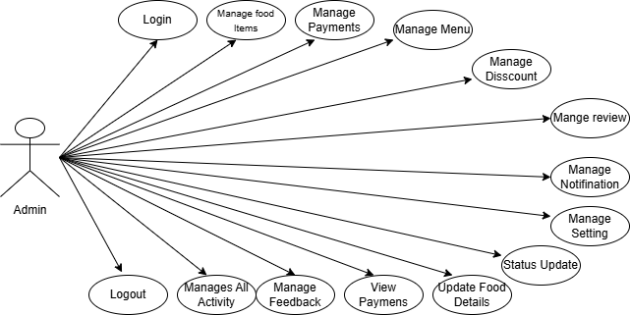
UML Diagrams
Admin

Slide 16
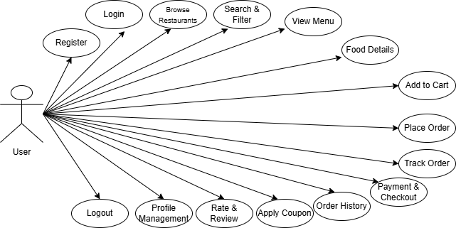
UML Diagrams
User

Slide 17
Activity Diagrams

Slide 18
System Diagrams
Table Structure
Screen Layout

Slide 19
Table Structure

Slide 20
Table Name : Users
Use : To store all user related data
Field | Type | Constraints | Description
Id | Int(11) | Primary Key | Unique Field
fisrtname | String | Required | Specify Name.
lastname | String | Required | Specify Name.
Email | String | Not Null (Unique Key) | Stores EmailID.
Password | String | Not Null | Specify Password.
CardData | Object | Array | Default: empty array
Dateofbirth | String | Required | Date of Birth
Gender | String | Required | Gender
phonenumber | String | Required | Phone Number

Slide 21
Table Name : Order
Use : To store all user order related data
Field | Type | Constraints | Description
userId | String | Required | Stores the user's unique ID who placed the order.
items | Array | Required | Contains a list of ordered products (productId, quantity, price, etc.).
amount | Number | Required, Must be positive | Total amount for the order.
address | Object | Default: "Food Processing", Enum: ["Food Processing", "Out for Delivery", "Delivered", "Cancelled"] | Indicates the current status of the order.
status | String | Array | Default: empty array
payment | Boolean | Default: false | Indicates whether the payment is completed (true/false).
createdAt | Date | Auto-generated by timestamps: true | Auto-generated by timestamps: true
updatedAt | Date | Auto-generated by timestamps: true | Stores the timestamp when the order was last updated.

Slide 22
Table Name : Food
Use : To store all Food related data
Field | Type | Constraints | Description
name | String | Required | Stores the name of the product.
description | String | Required | Provides details about the product.
price | Number | Required, Must be positive | Stores the price of the product.
image | String | Required | Stores the image URL or file path for the product.
category | String | Required | Specifies the category to which the product belongs.
createdAt | Date | Auto-generated by timestamps: true | Stores the timestamp when the product was added.
updatedAt | Date | Auto-generated by timestamps: true | Stores the timestamp when the order was last updated.

Slide 23
Table Name : Feedback
Use : To store all Feedback related data
Field | Type | Constraints | Description
orderId | String | Required | Stores the id of the product.
Rating | Number | Required | Provides rating about the product.
comments | String | Required | Stores the comments given by user for the product.
active | String | Required | Specifies the status of the product.
createdAt | Date | Auto-generated by timestamps: true | Stores the timestamp when the product was added.
updatedAt | Date | Auto-generated by timestamps: true | Stores the timestamp when the order was last updated.

Slide 24
Table Name : Promocode
Use : To store all promocode related data
Field | Type | Constraints | Description
code | String | Required | Promocode
Discount Type | String | Required | percentage
Discount value | Number | Required | Stores the diss value.
minorderamount | Number | Required | Min order amt.
Maxdiscountamount | Number | Required | Max diss amt.
Expirydate | Date | Required | Expiry date.
usagelimit | Number | Defoult:1 | Usage limit
isactive | Boolean | Defoult: false | status

Slide 25
Table Name : Admin
Use : To store all admin related data
Field | Type | Constraints | Description
firstname | String | Required | Stores the name of the admin.
lastname | String | Required | Stores the name of the admin.
dateofjoingng | Date | Required | Date of joining.
email | Number | Required | Email of admin
mobilenumber | String | Required | Number of admin.
address | String | Required | Address of admin.
password | String | Required | Password.
profilepic | String | Defoult | Defoult profile pic.

Slide 26
Screen Layouts

Slide 27
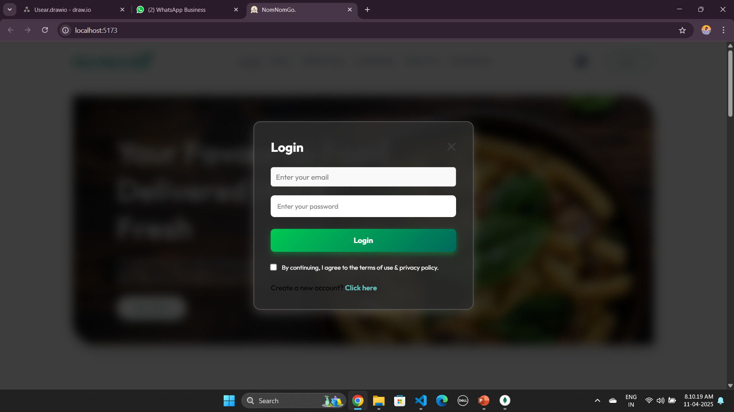
Login : user

Slide 28
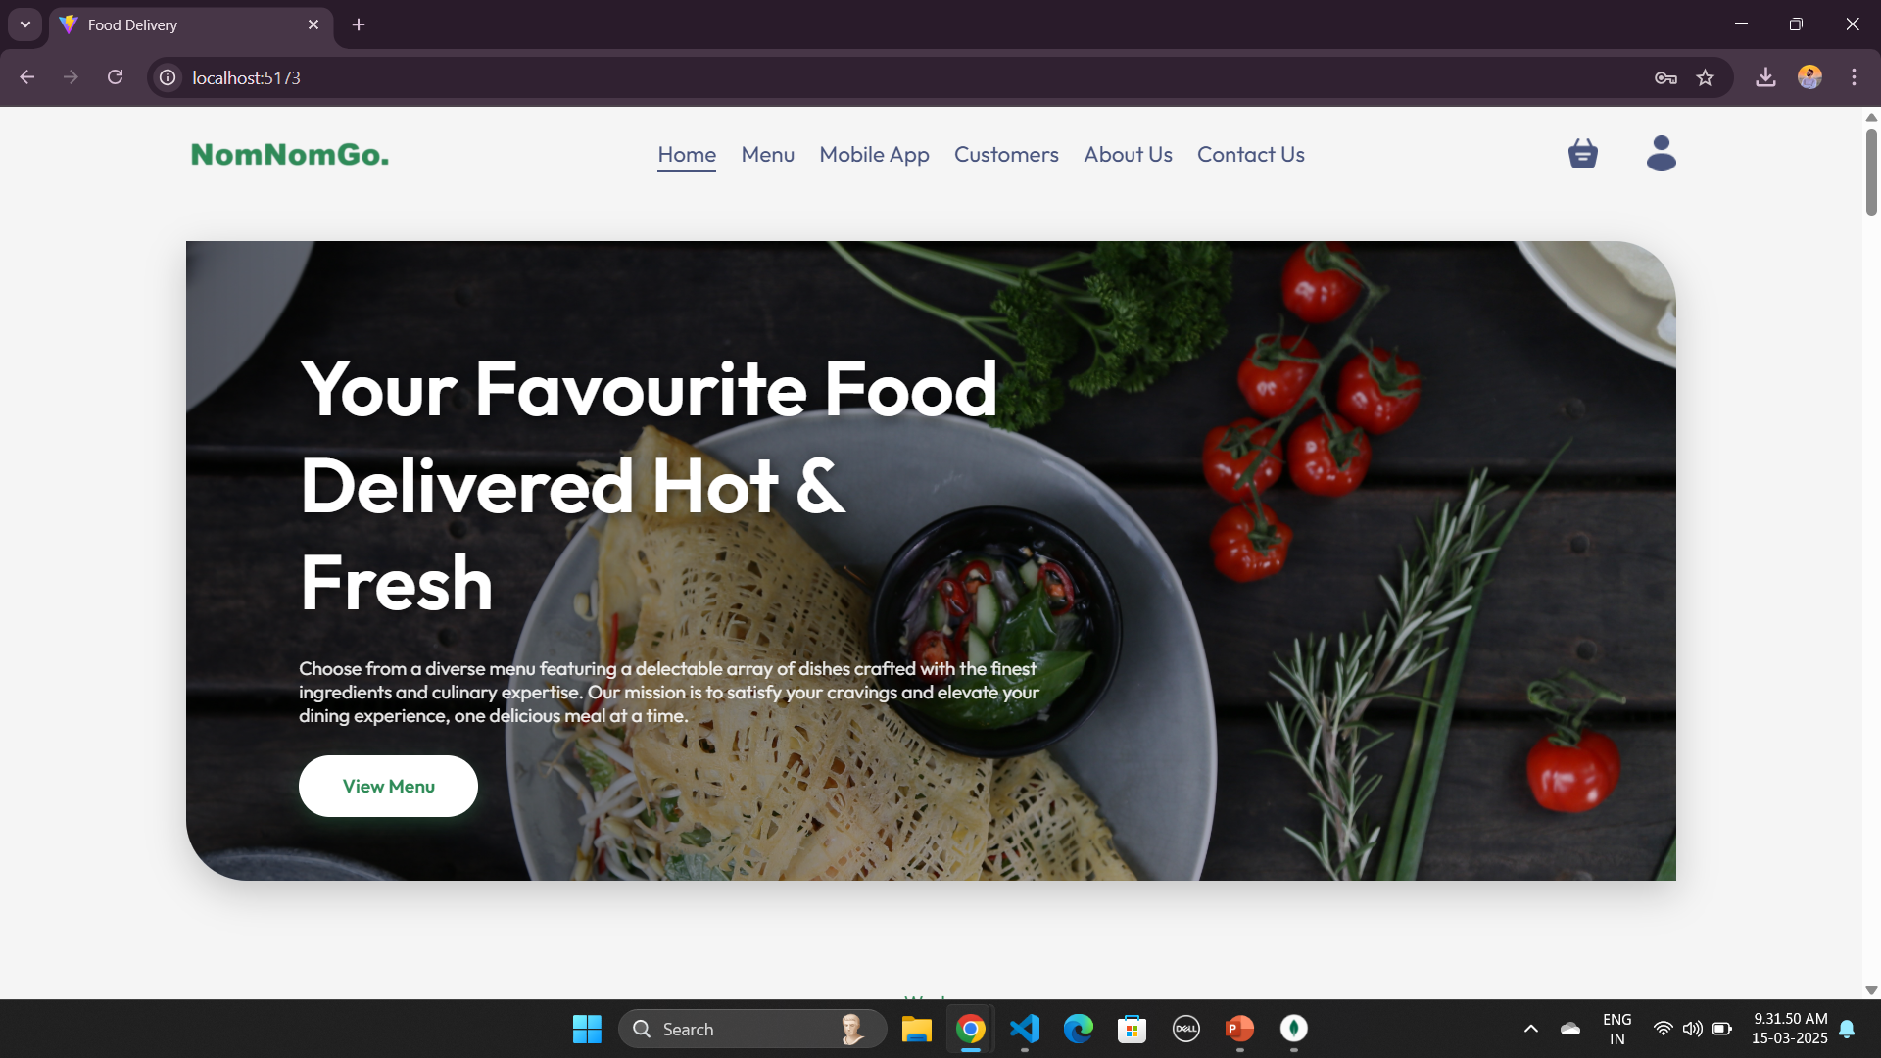
Home Page (Client Side) :

Slide 29
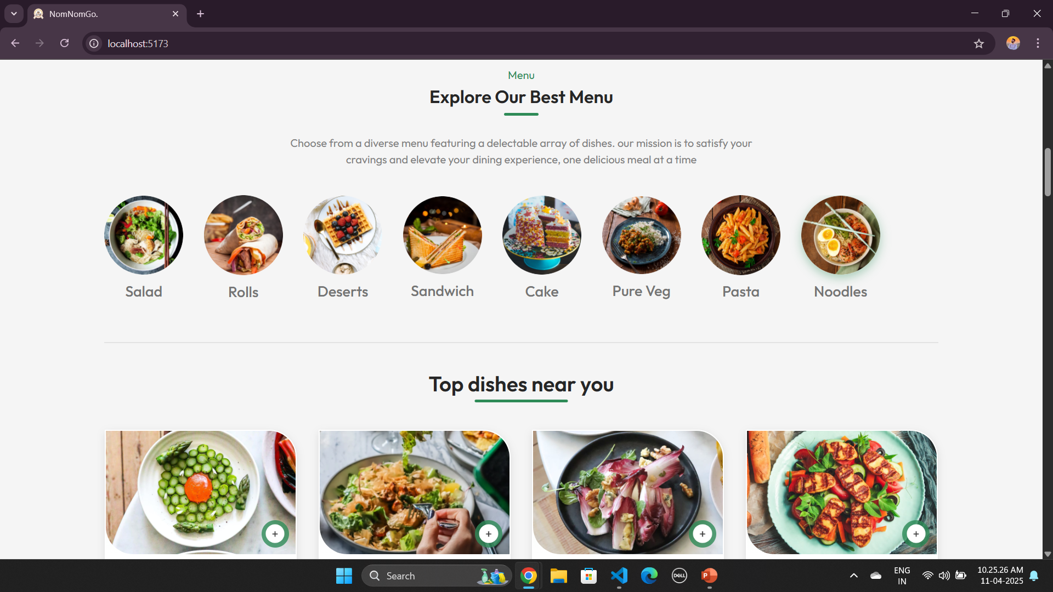
Menu Page :

Slide 30
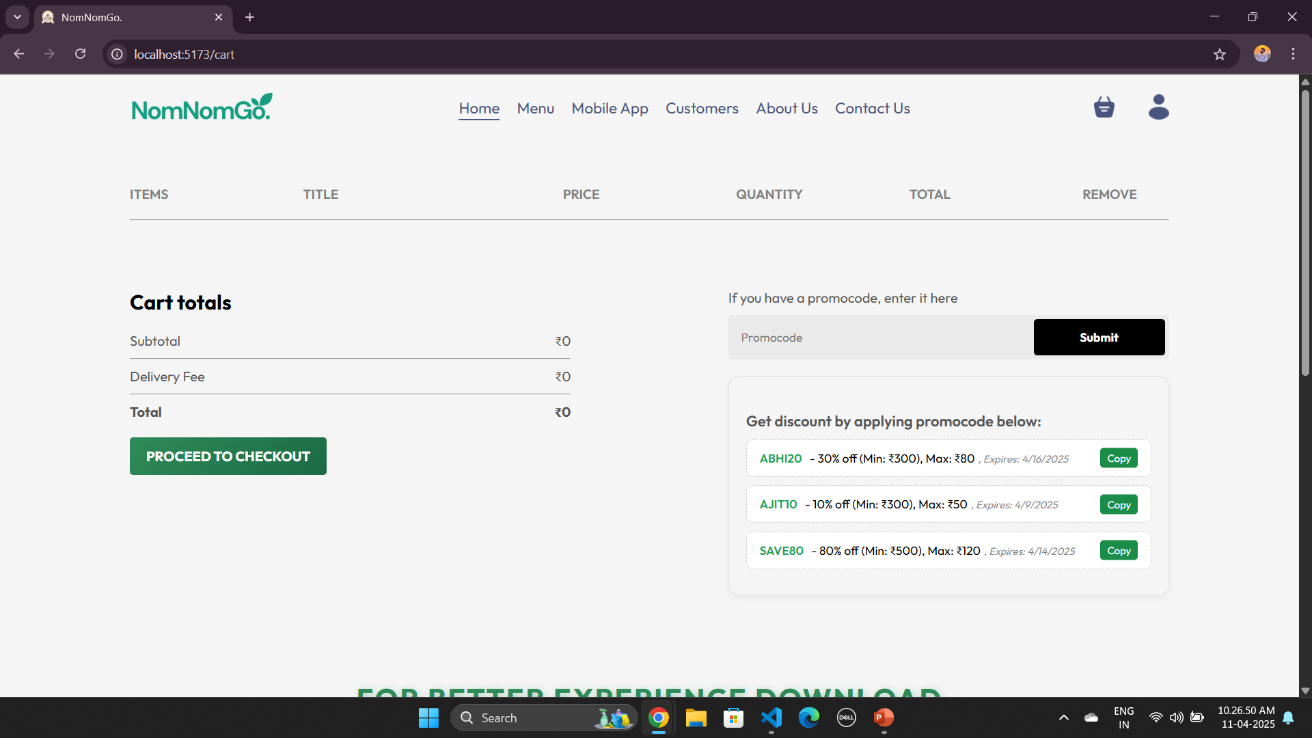
Cart Page :

Slide 31
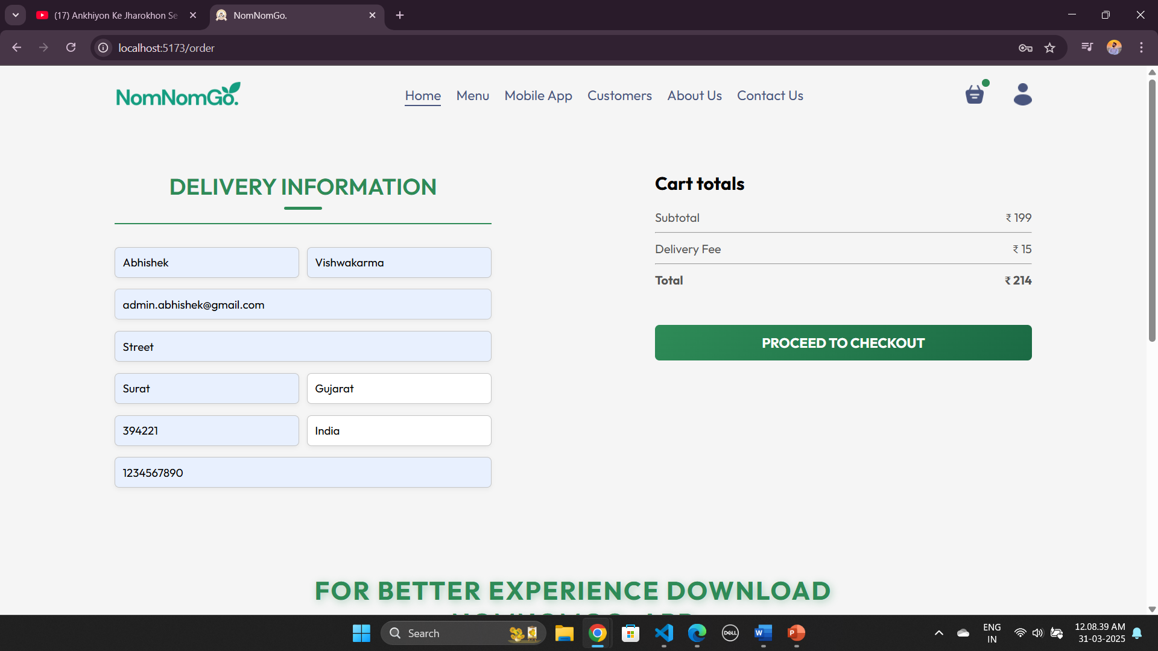
Delivery Details Page :

Slide 32
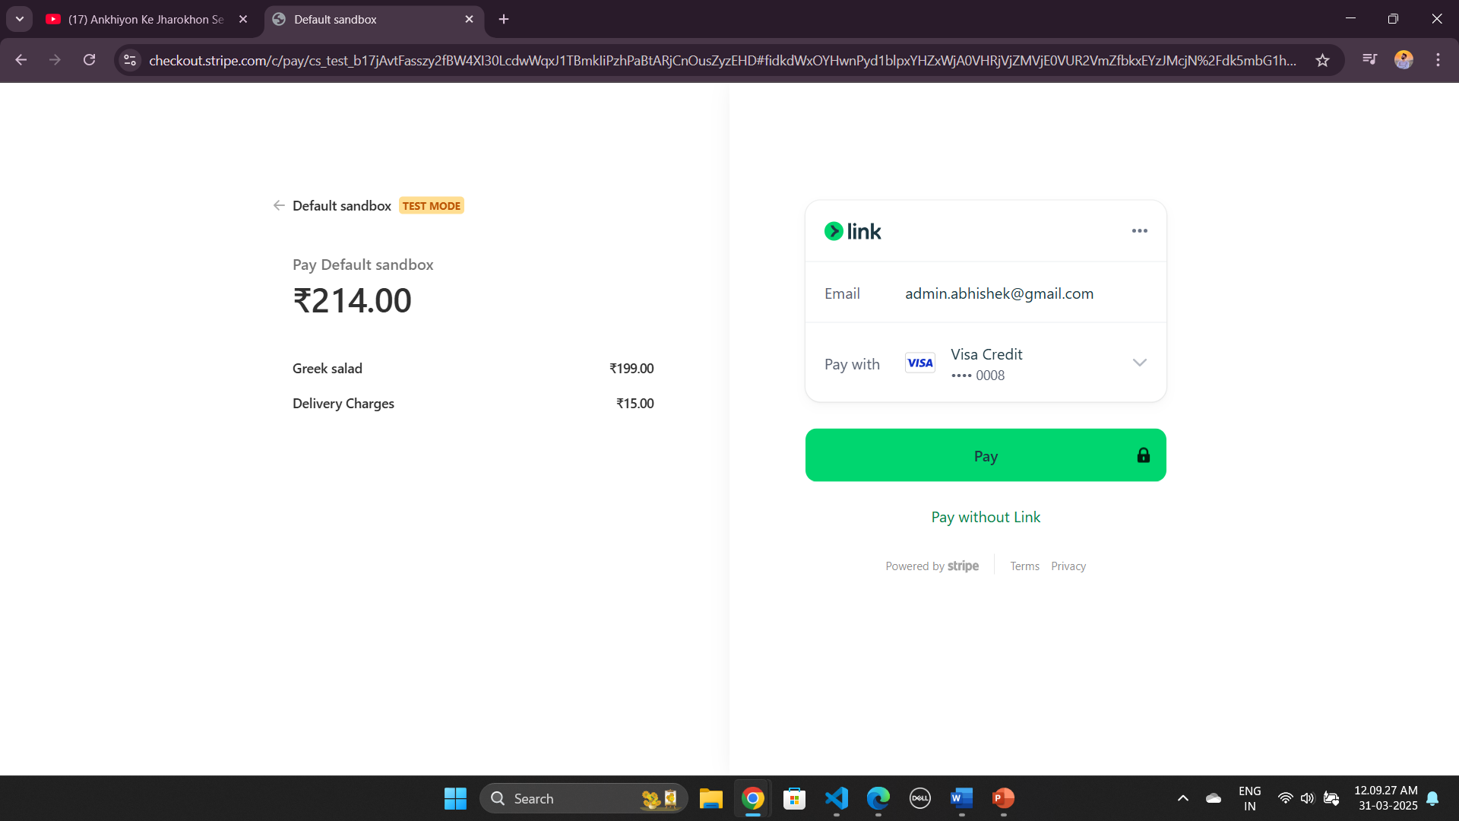
Payment Page :

Slide 33
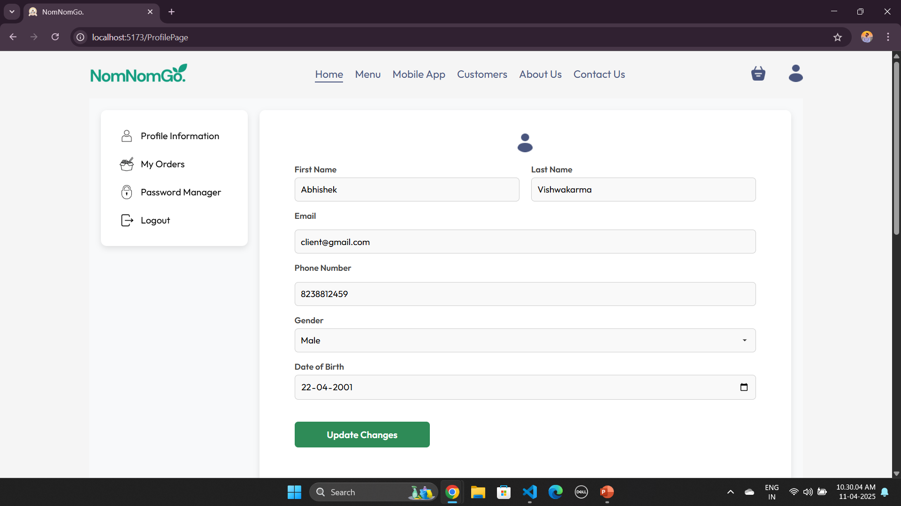
Account Page :

Slide 34
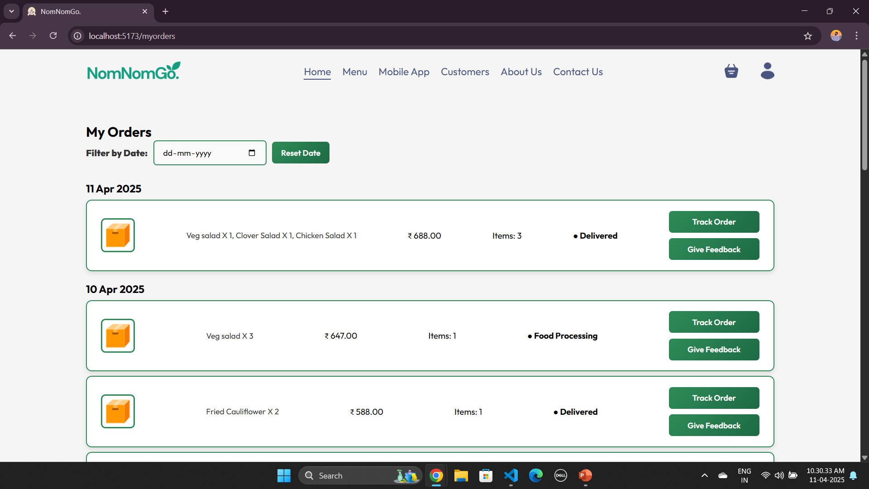
Orders Page :

Slide 35
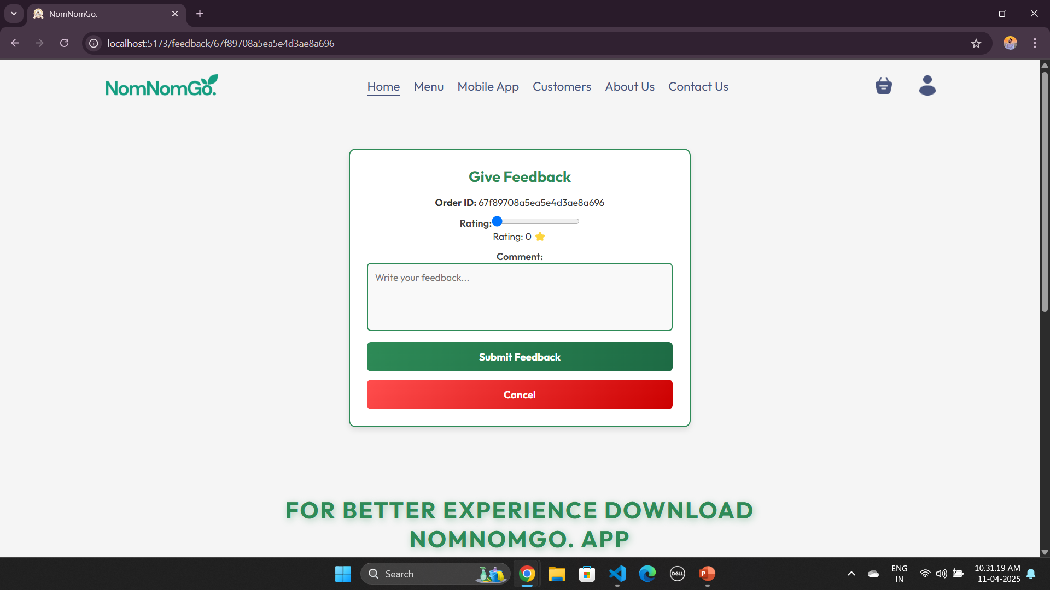
Feedback Page :

Slide 36
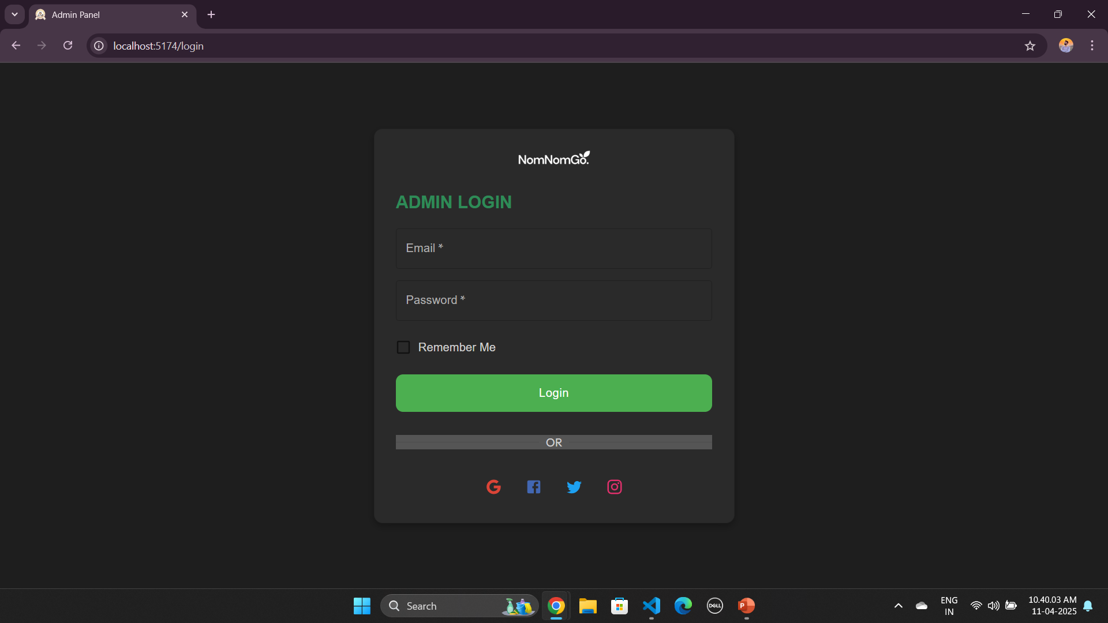
Admin Login Page :

Slide 37
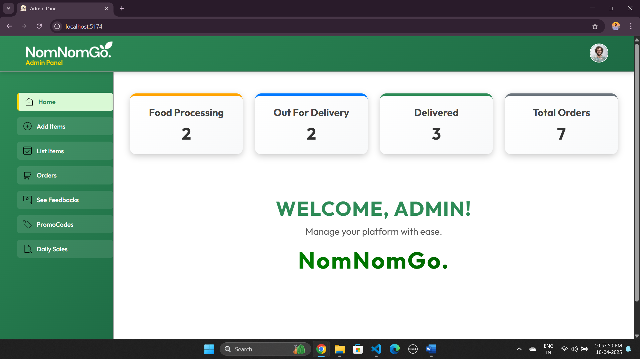
Admin Page :

Slide 38
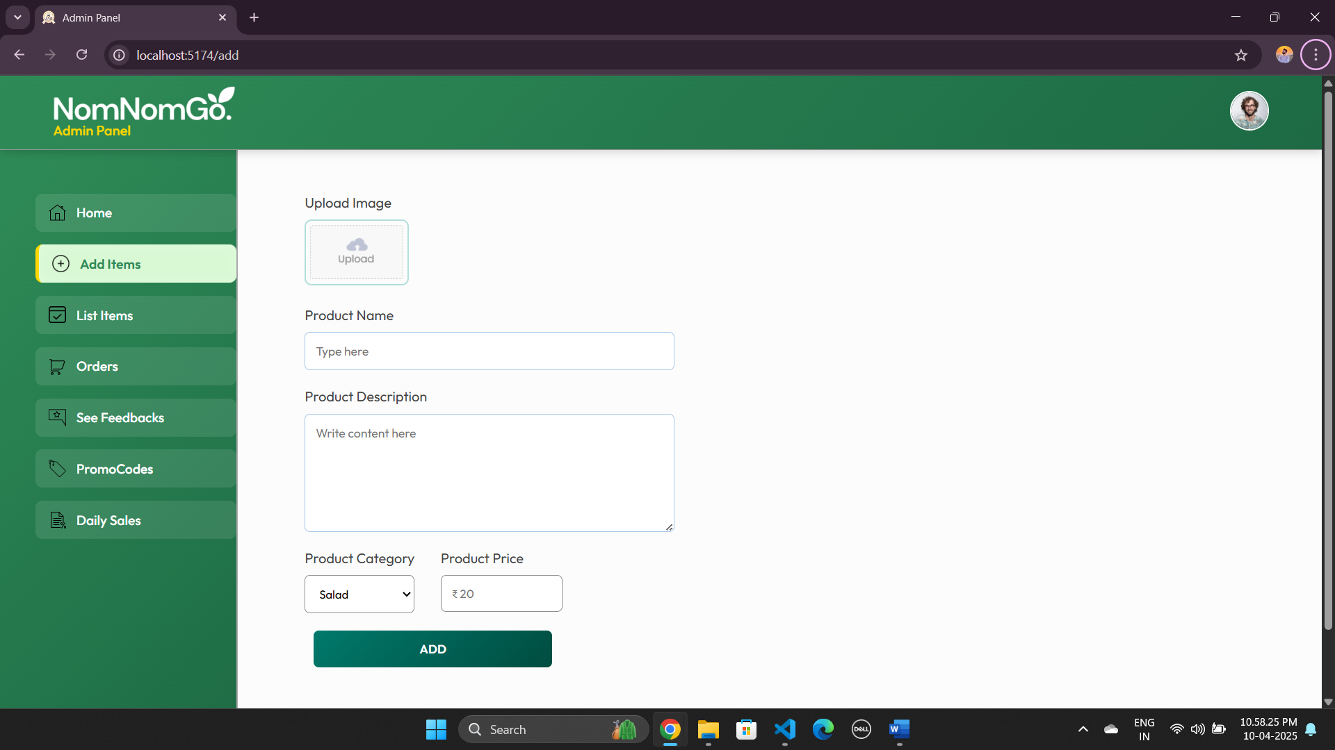
Product Add Page :

Slide 39
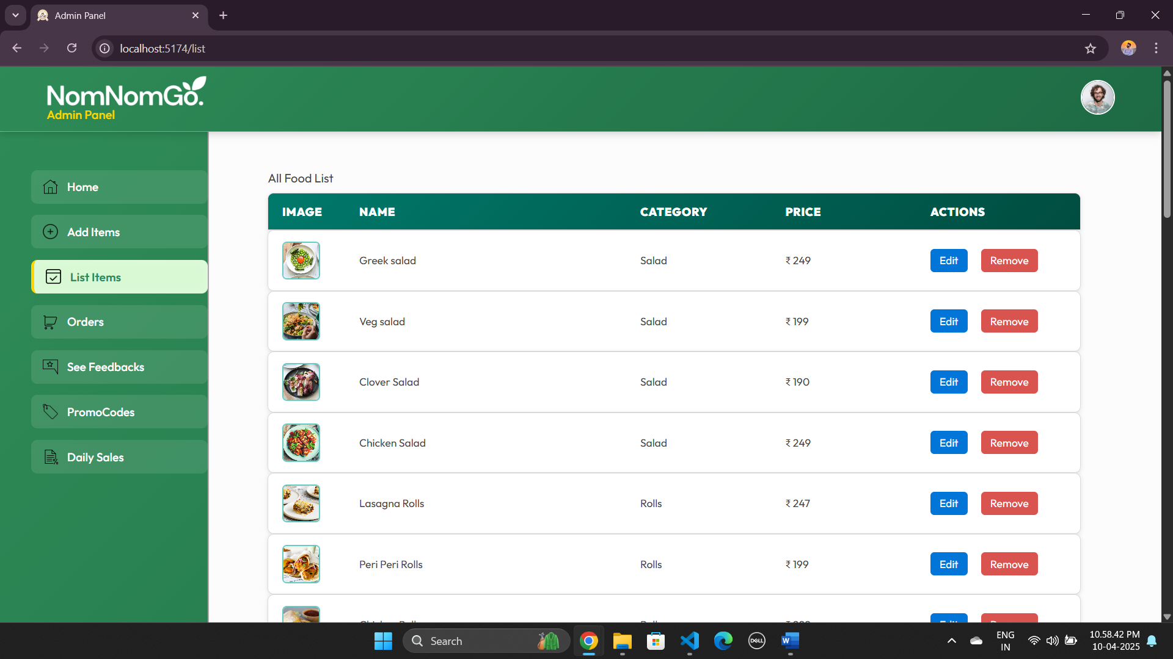
List Product Page :

Slide 40
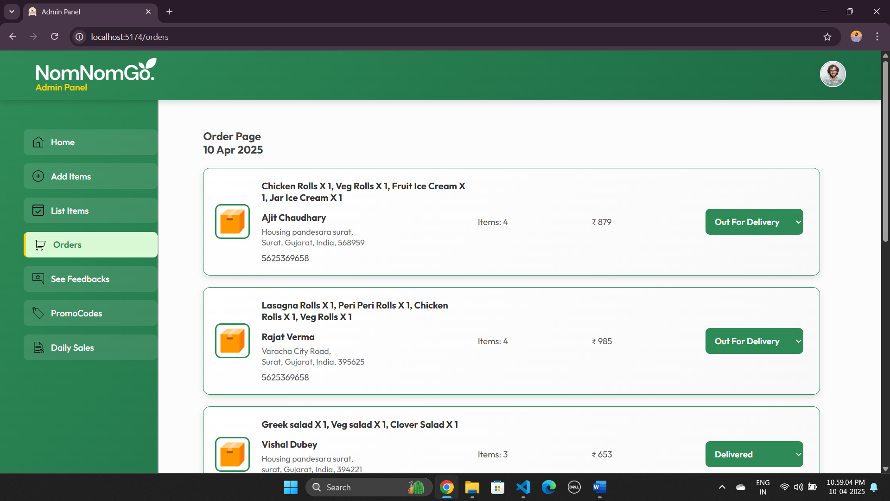
Orders Page :

Slide 41
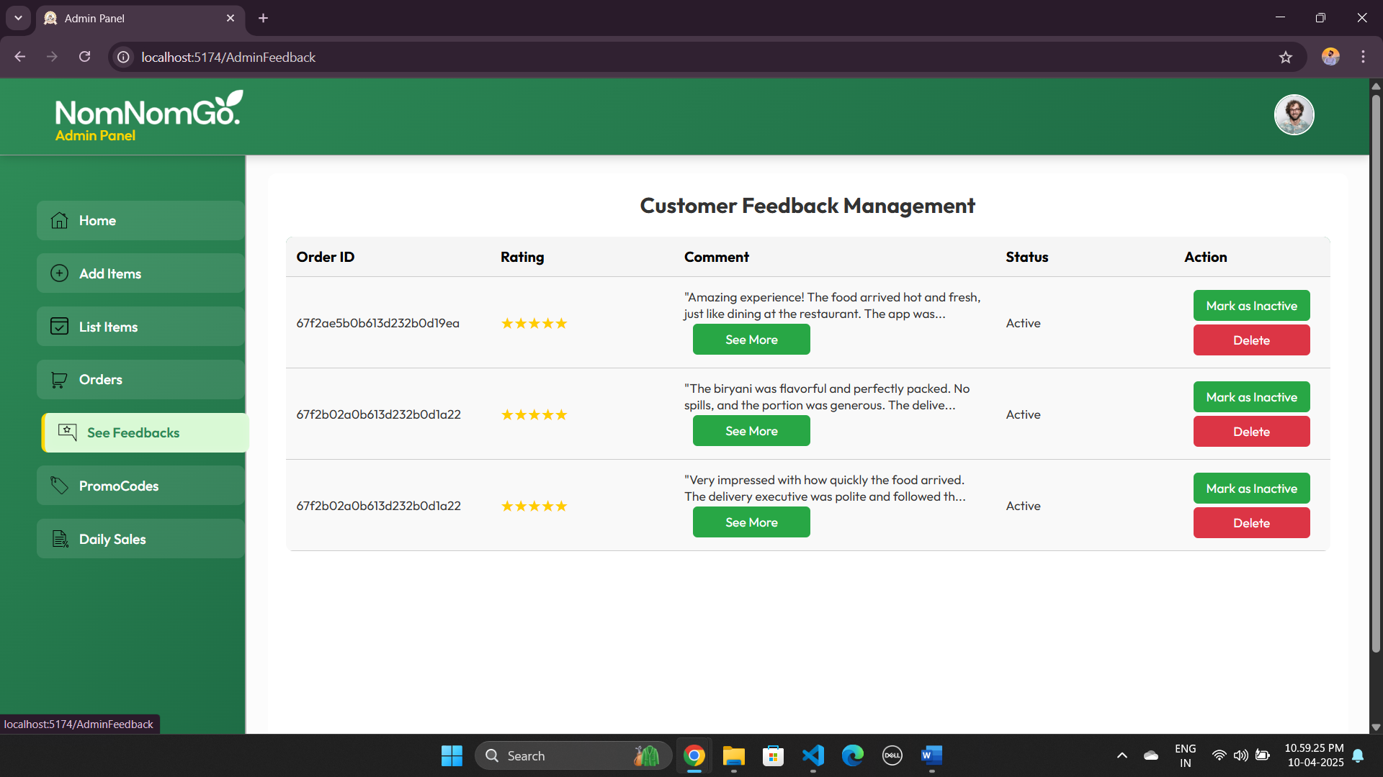
Feedback Page :

Slide 42
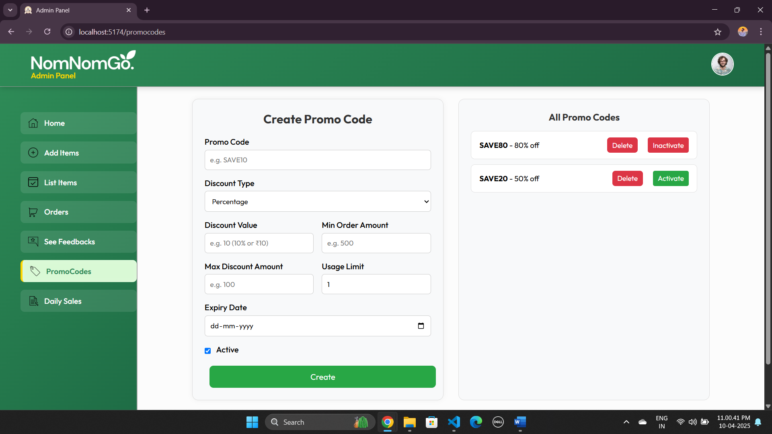
Promocode Page :

Slide 43
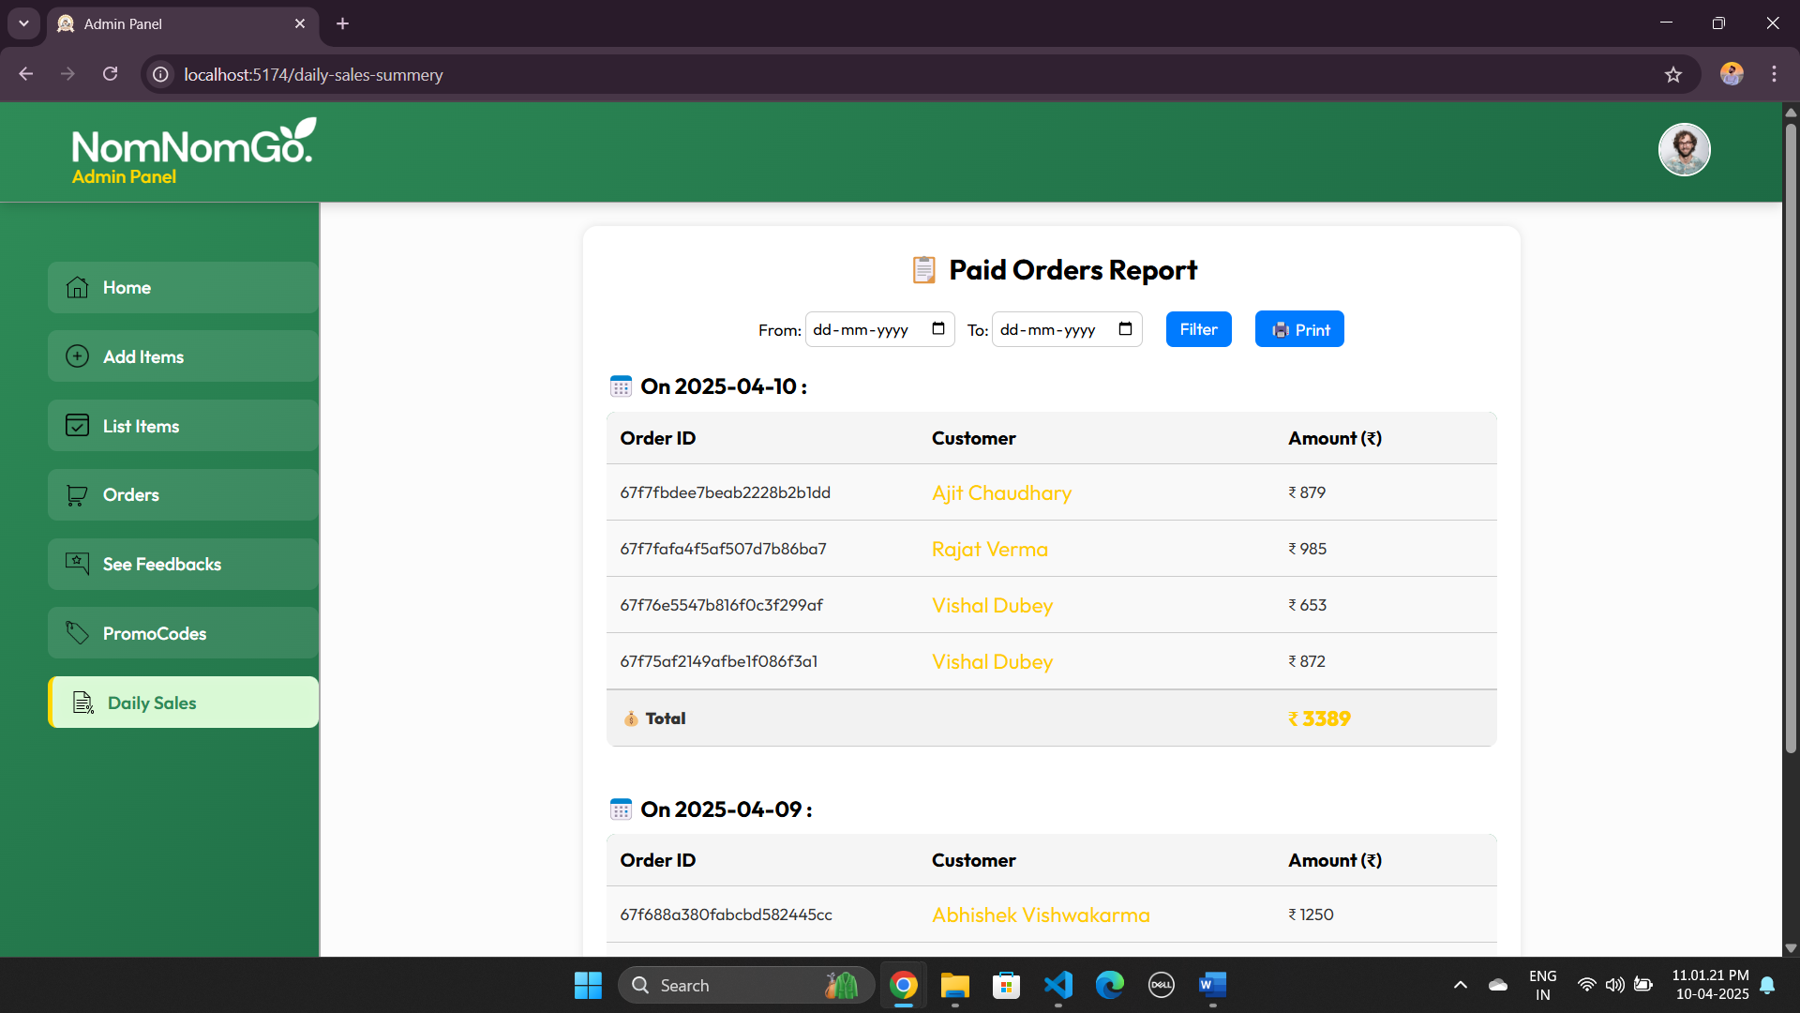
Promocode Page :

